Slide 1



East Midlands Breast Pain Pathway:
Community Breast Pain Clinics:
‘National’ audit
John Robertson on behalf of the
East Midlands Breast Pain Pathway Implementation Team

Slide 2
East Midlands Breast Pain Pathway
    Four key components:
      1) Breast pain – no relationship to breast cancer
      2) Community/Primary Care setting
      3) Experienced breast clinician confirms no clinical abnormality Patient has no other symptoms
      4) FH risk assessment
      NICE CG164 - performed as part of initial triage

Slide 3
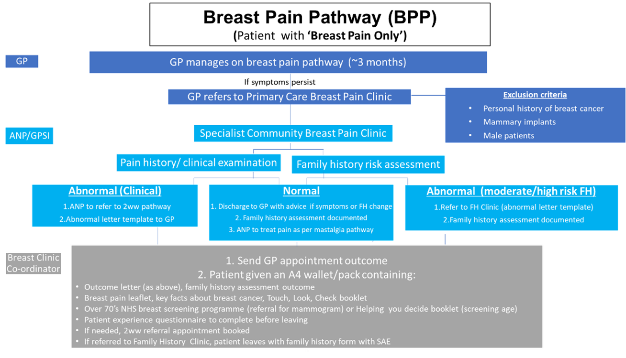

Breast cancer diagnostic pathway
Example Breast Pain Pathway from the East Midlands Cancer Alliance
Benefits
Key benefits of the pathway include:
Improved patient experience
Reduction in secondary care 2WW referrals
Better use of resources including imaging capacity
Improved early detection of significant breast cancer family history
Further information
See the East Midlands Cancer Alliance website
for more
information,
resources and data.

Slide 4
Faster Diagnosis Pathway Guidance March 2024
Executive Summary
“A departure from historic practice by mandating triage of all referrals and diversion of patients away from the one-stop clinics for those at low risk of a cancer diagnosis who do not have red flag symptoms”
“Ensures that those at low risk are seen in an appropriate setting and avoid the unnecessary imaging that often occurs in the one stop clinic”
“Most of these patients can be seen by a single clinician, and do not need the multidisciplinary resource of the one-stop clinic”
“Ensure the best use of one-stop clinic resource, reduce unnecessary and inappropriate imaging, and improve patient care”
“New pathways for management of patients with symptoms of breast pain should be evaluated to ensure safety and patient satisfaction”

Slide 5
Publications
a) Sherwood Forest Hospitals NHS Trust pilot – published BMJ OQ (2022)
Transforming the 2-week wait (2WW) pathway: management of breast pain in primary care | BMJ Open Quality
b) Derbyshire pilot – published BMJ OQ (2024)
Community breast pain clinics can provide safe, quality care for women presenting with breast pain | BMJ Open Quality
c) East Midlands audit – accepted ‘Journal of Evaluation in Clinical Practice’ (2025)
- EMCA: all 5 EM ICBs
- Report on EMCA website
d) National evaluation– Manuscript being re-submitted with minor amendments
- 17 centres and 9 Cancer Alliances
- Report on EMCA website

Slide 6


Community Breast Pain Clinics
Building an evidence base
Mid-Notts Derbyshire East Midlands National
● Feasible
● Scalable
● Acceptable(patients)
● Safety
● Cost effective
● Reproducible
● Sustainable
(06/21) (01/22) (09/23) (12/24)
?
?
?
?
?
?
?

Slide 7
Core dataset
Five distinct data inputs:
  • Core demographic and referral data obtained via local hospital systems
  • Breast Pain Clinic outcome data collected on the day of attendance
  • Risk assessment data following input to FaHRAS on day of clinic
  • Patient Reported Outcome Measures (PROMs) collected at the clinic visit
  • Follow up data: subsequent 2WW clinic attendance or cancer diagnosis

Slide 8
Cancer Alliances & Centres of the National EMMP Audit
Cohort A | East Midlands – whole CA including all 5 shires (Derbyshire, Nottinghamshire, Leicestershire, Lincolnshire & Northamptonshire)
 | Humber and North Yorkshire – York & Northern Lincolnshire & Goole
 | East of England (N&S) – East Sussex & North Essex FT & Peterborough, East & North Hertfordshire Trust
 | South Yorkshire – Doncaster
 | LSCCA – East Lancashire Hospital Trust
 | Merseyside & Cheshire – Mersey and West Lancashire Teaching Hospitals
 | West Midlands – South Staffordshire
Cohort B | South Yorkshire - Bassetlaw Teaching Hospitals
 | Merseyside & Cheshire – Countess of Chester Hospital
 | North Central London – Royal Free Hospital

Slide 9
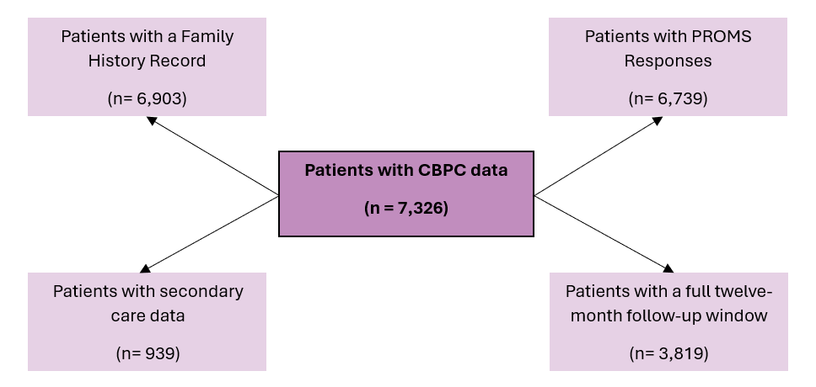
National Audit: Patients Evaluated
92%
94.4%
12.8%
52.1%
Median Age 48 years (range 16-92)

Slide 10
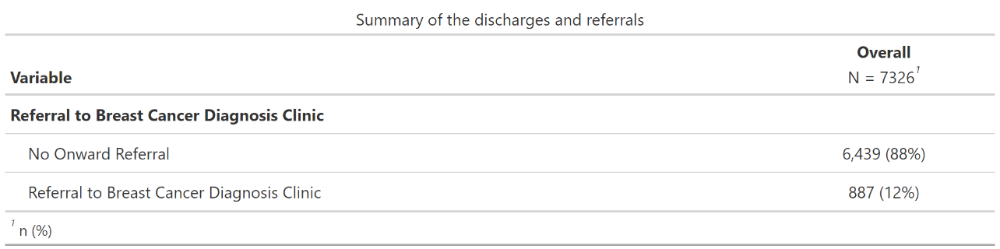
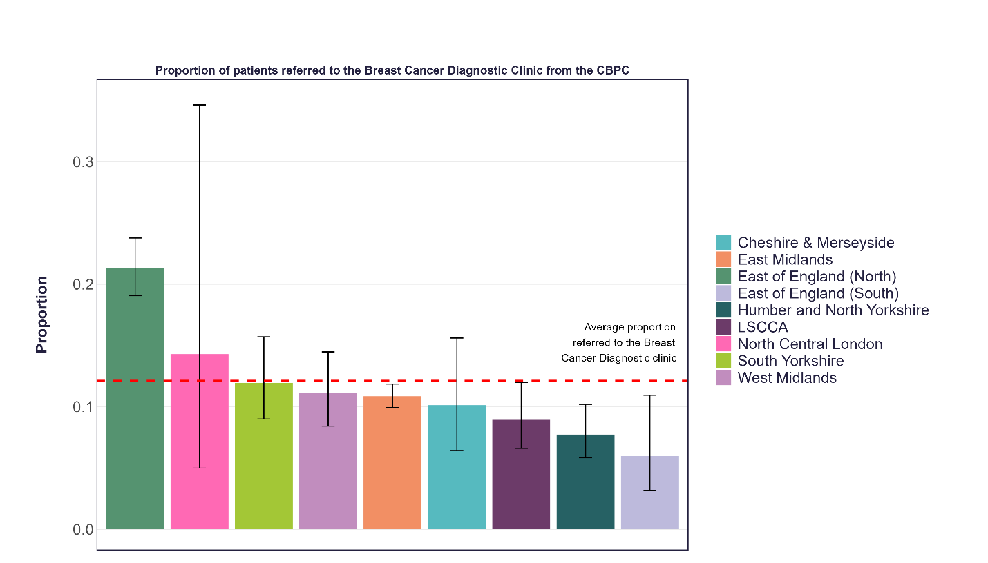
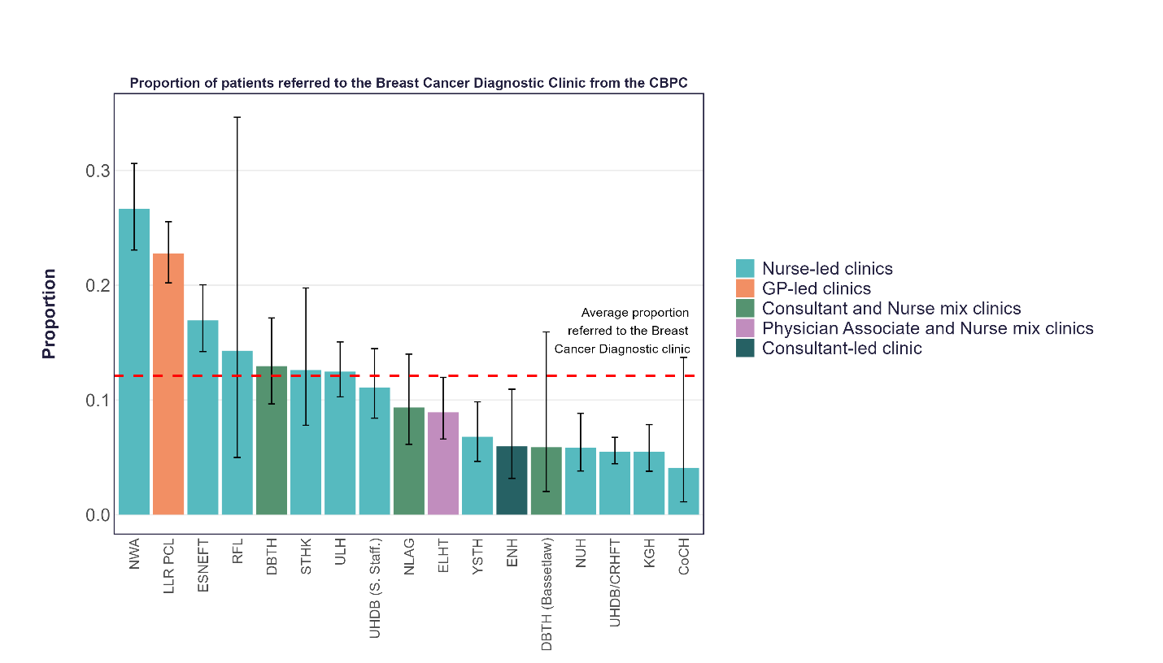
National Audit: Breast Cancer Diagnostic Clinic Referrals
Referrals by CBPC Cancer Alliance
Referrals by Clinical Model

Slide 11
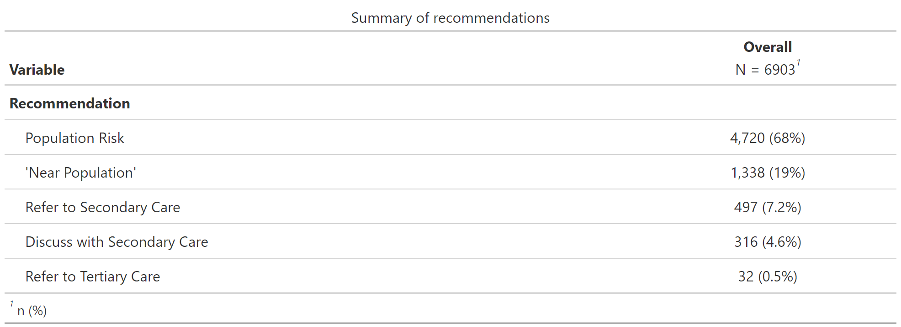
National Audit: Family History Risk Assessment
Percentage above “near population risk”: 12.3%
Percentage with FH of breast cancer: 31.3%

Slide 12
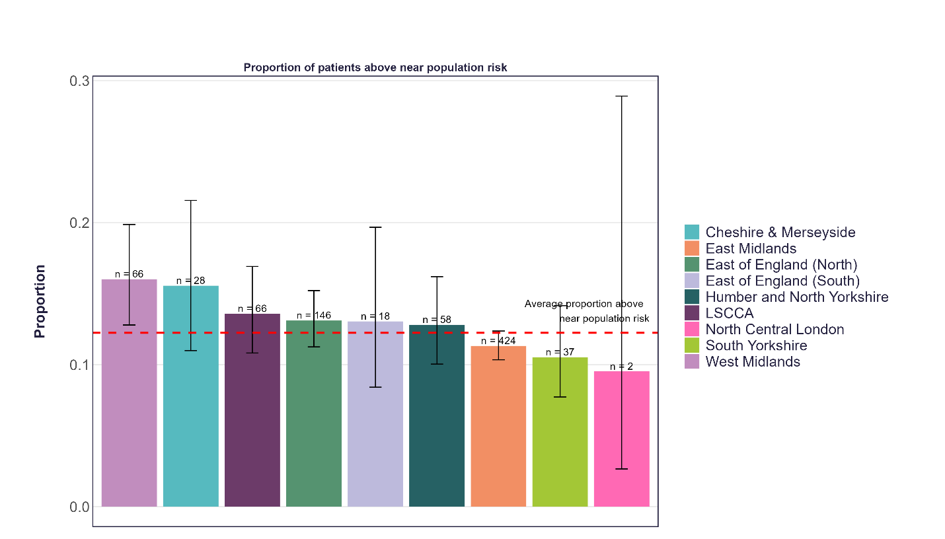
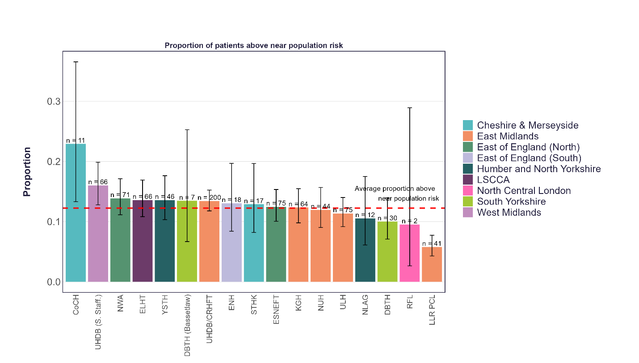
National Audit: Family History Risk Assessment
Patients above “near population risk” by CBPC Cancer Alliance
Patients above “near population risk” by CBPC Site

Slide 13
National Audit: Patent Recorded Outcome Measures
Anonymised questionnaires completed after clinic visit
Did you find the pain advice you received helpful? 98%
Did you feel reassured by the breast pain advice? 98%
Did you find the personal risk assessment helpful? 97%
Extremely likely or likely to recommend the service to friends and family if they had 99%
troublesome breast pain?

Slide 14


National Audit: Patent Recorded Outcome Measures
Patient Feelings
Before
After

Slide 15
National Audit: Breast Cancer Diagnoses and Incidence
All patients with 12 month follow up
 | All Patients | Eligible Patients
Attendances | 3,819 | -
Diagnoses | 17 | 14
Incidence | 4.5 per 1,000 (CI: 2.8-7.1) | 3.7 per 1,000 (CI: 2.2-6.2)
Eligible patients with 12 months follow-up
 | Statistic
Eligible diagnoses with 12-month follow-up | 14
Direct CBPC referral | 8
Via Screening (Within 2 months of CPBC) | 3
Via Screening (Not within 2 months of CPBC) | 2
Via GP | 1

Slide 16
National Audit: Cost-Benefit Analysis
Year | Number of Sites | Estimated Total Benefits | Estimated Total Costs | CBR | Net benefit
1 | 14 | £1,013,952 | £805,520 | 1.29 | +£208,432
1 & 2 | 12 | £1,700,802 | £1,211,341 | 1.40 | +£489,462
1 & 2 & 3 | 3 | £805,910 | £517,833 | 1.56 | +£288,077
Please note the year indicates the number of years since each clinic opened. Where a clinic had not been open for a full year, the activity was adjusted for the number of days open within that year.

Slide 17


Additional EMBPP Benefits
  Reducing pressures on the Breast Cancer Diagnostic Clinic and diagnostic imaging capacity.
      There is the potential to reduce the number of Breast Cancer Diagnostic Clinic referrals by up to 20%.
      This could lead to shorter waiting times - time to diagnosis, treatment and longer-term outcomes improve.
  Environmental benefits as patient travel time should decreased as they could attend a CBPC in the community rather than travelling to large secondary care centres.

Slide 18
Community Breast Pain Clinics
Building an evidence base
Mid-Notts Derbyshire East Midlands National
● Feasible
● Scalable
● Acceptable(patients)
● Safety
● Cost effective
● Reproducible
● Sustainable
(06/21) (01/22) (09/23) (12/24)

Slide 19
Conclusions
The key findings of the audit is that the EM CBPC model is reproducible across 17 sites nationally.
This reproducibility can be seen in:
  Patient Experience
      Extremely positive across all sites and all measurements of the CBPC.
  Health Economics
      Across the centres the CBPC has proven to be cost effective, with a few exceptions.
      Improvement in cost effectiveness in later years reflects increasing productivity and discharge rates.
  Patient Safety
      No delays to care identified.
      Additional cases picked up due to screening.
  Cancer Prevalence
      Patients with full 12-month follow up data is close to the national prevalence expectation in the general population.

Slide 20
EMBPP Legacy Website
Patients & Public - East Midlands Breast Pain Pathway
https://eastmidlandscanceralliance.nhs.uk/patient/east-midlands-breast-pain-pathway-patientpublic
East Midlands Breast Pain Pathway for Professionals - Implementing the EMBPP
https:// eastmidlandscanceralliance.nhs.uk/professional/east-midlands-breast-pain-pathway-register

Slide 21
Acknowledgements
East Midlands AHSN
East Midlands Cancer Alliance
East Midlands Breast Cancer ECAG
EM Primary Care Transformation Group
Association of Breast Surgery
Derby Breast Surgeons
Mid Notts BP pilot team
Derbyshire BP pilot team,
Derbyshire, Leicestershire, Lincolnshire, Northamptonshire & Nottinghamshire implementation teams
FaHRAS
Implementation of the East Midlands Breast Pain Clinic Model has been facilitated through a collaborative agreement between Roche Products Limited and HITS (Health Improvement Transformation Strategies), a Community Interest Company

